Slide 1
Federal Health Architecture: The Federal Advantage
June 1, 2016

Slide 2
Today’s Topics
FHA Overview
FHIM
Harmonization of the Information Models
CONNECT
Closing Remarks and Questions

Slide 3
Federal Health Architecture Overview
Gail Kalbfleisch, Director, FHA

Slide 4
Agenda at a Glance
FHA Overview: FHA and it’s Role in the Health Ecosystem
FHA at Work: Past, Present, and Future Initiatives
Enterprise Architecture: Building the Bridge of Interoperability

Slide 5
FHA OVERVIEW: What is FHA and its Role in the Federal Health Ecosystem?

Slide 6
What is FHA?
Established as an E-Government Line of Business in 2005
Engages with federal stakeholders and their exchange partners
Supports federal health IT standards and policy activities
Enables federal health agencies to improve the exchange of health data
Notes:
What is FHA?
Established by the Office of Management and Budget as an E-Government Line of Business Initiative
Supports federal activities related to the development and adoption of health IT standards and policies
Ensures that federal agencies seamlessly and securely exchange health data with other agencies, government entities, and with other public and private organizations
Reaches out to more than 20 federal agencies to advance the national agenda for health IT

Slide 7

What agencies are in FHA?
FHA partners with more than 20 federal agencies
Notes:
FHA partners with more than 20 federal agencies including the Department of Health and Human Services, Department of Defense, Centers for Medicare & Medicaid Services, Department of Veterans’ Affairs, Social Security Administration and Indian Health Services

Slide 8
What is the role of FHA?
Define
Coordinate
Convene
Collaborate
Communicate
Document
Notes:
Define elements of the federal health IT ecosystem
Coordinate a federal voice for health IT
Convene federal experts in the identification and resolution of common business & technical Health IT problems
Collaborate with federal partners to define outcome-based solutions based on interoperability metrics
Communicate elements of the federal health IT ecosystem
Support federal partner priorities and promote success stories with communications and outreach

Slide 9
FHA at Work: Past, Present, and Future Initiatives

Slide 10
FHA’s Contributions to Health IT
Directed Exchange
Health Care Directory
Past: Federal requirements for implementation
Present: Implementation support
Future: Ad hoc support
Past: Federal partners’ healthcare directory requirements
Present: Evaluation of data elements
Future: Identify federal solution

Slide 11
FHA’s Contributions to Health IT
Patient Consent & Authorization
Patient Matching
Past: Identify federal barriers to information sharing
Present: Support ONC privacy office
Future: None identified
Past: Not previously supported
Present: Collaborating with DoD, VA, and IHS
Future: TBD

Slide 12
FHA’s Contributions to Health IT
Health Information Modeling
NIEM
Past: FHIM “single standards solution” for health information modeling
Present: Alignment of FHIM & CIMI; Implementation guides
Future: Collaboration with modeling community, vocabulary sets, new standards
Past: Monitored
Present: Steward of health domain
Future: NIEM alignment with health standards
Notes:
NIEM: National Information Exchange Model
Widely used across the federal, state, and local governments
The National Information Exchange Model (NIEM) is a community-driven, standards-based approach to exchanging information. Currently, NIEM exchanges are being developed to allow for a more efficient and consistent method of sharing important public health and safety information, representing a significant first step in the development of a borderless network of information exchange between the U.S., Canada, and Mexico. As of 2015, FHA is new NIEM Health Domain Steward and will receive NIEM community use cases with healthcare components requiring FHA/FHIM guidance.

Slide 13
FHA’s Contributions to Health IT
ONC Interoperability Roadmap
HIMSS
Past: ONC strategy and Roadmap
Present: Collaborating with federal partners on CCMs
Future: Reporting and collaborating on implementation of CCMs
Past: 8 years
Present: Manage federal participation of the showcase
Future: Coordinate showcase scenarios among federal agencies
Notes:
Next steps for FHA include:
Compiling inputs as they are submitted
Developing additional analysis based on submissions from federal partner agencies
Developing agency specific reports for the next group of partner agencies
Identifying the next set of partner agencies to send data call

Slide 14
Enterprise Architecture: Building the Bridge of Interoperability

Slide 15

Value of Architecture
Comprehensive view of enterprise
Reduces costs
Understand risks
Saves time
Improves communication
Exposes complex interactions

Slide 16

The Purpose of FHA’s EA
Cross agency evaluation to identify possibilities to converge on agreed upon:
Standards
Processes
Policy
Services
Notes:
Cross agency evaluation to identify possibilities to converge on agreed upon Standards, Processes, Policy, & Services

Slide 17
FHA Strategic Decision Support
Strategic decision support across the federal health landscape
Data standards
Opportunities for collaboration
Developed proof of concept strategic decision support tool in FY 2015
Tool and visualizations
Notes:
FHA supports strategic decision making by aggregating information across the Federal Health Landscape
Collection of currently used and emerging data standards
Illustration of opportunities for collaboration across Federal Partners that perform similar functions
Identification of Federal Partner areas for cooperation in support of the ONC Interoperability Roadmap
Developed proof of concept supporting tool in FY 2015
Currently working on prototype tool and visualizations to support strategic decision making

Slide 18
Thanks for Listening!
Any questions for Gail?

Slide 19
FHIM Overview: How the FHIM can organize other information modeling efforts
Galen Mulrooney, Project Manager-FHIM, FHA

Slide 20
Background: FHA projects
An important goal of the FHA is to enable interoperability between partner agencies and with their private sector partners, and have several projects towards that goal
Interoperability is facilitated when agency enterprise architecture components are closely aligned with Health IT Standards
However, there are gaps and overlaps between the standards
Many standards leave some details to the implementers, especially choices in terminologies used
Notes:
Please use the slide construction guidelines included on the next slide within your presentation.

Slide 21
Background: FHIM
Federal Health Information Model (FHIM):
A logical health information model that supports semantic interoperability
Built by harmonizing information from the individual Federal partners and standards organizations
Goal is to establish a comprehensive, integrated set of standard “implementation guides” that fully support semantic interoperability
Has both structural and terminology components. FHIM coded concepts are “bound” to terminology in a separate FHIM Terminology Model via mechanisms adapted from MDHT
FHIM is a both a Logical Information Model (LIM) and a Platform Independent Model (PIM)
FHIM uses the HL7 Reference Information Model (RIM) as a reference model (FHIM can also use other reference models), yet is structurally aligned with FHIR
Notes:
Please use the slide construction guidelines included on the next slide within your presentation.

Slide 22
Benefits of Modeling
The models support efficient standards development
Standard ballot materials can be generated from the FHIM
The models are being integrated with the Model Driven Health Tools (MDHT) to support a model-driven approach to development of information exchange interoperability specifications
FHIM maintains traceability to underlying standards - especially HL7, NCPDP, and X12 – as well as to S&I Initiatives
FHIM derivative models add “interoperability use cases”, which provide additional constraints. These derivative models maintain traceability to the use cases and to the HL7 EHR-S Functional Model
The models can be leveraged by organizations for internal use in systems and database development
Notes:
Please use the slide construction guidelines included on the next slide within your presentation.

Slide 23
Benefits of Model-Driven Approach
Analyze once implement many times
Business/clinical concepts are the same regardless of what technology (or standard) in which they’re implemented
Provide consistency across the conceptual “landscape”
Each information exchange structure or detailed clinical model is consistent with others
Enables generation of code to reduce cost and human-introduced errors
Enables generation of other artifacts (e.g., implementation guides, developer interactive help)
Allows for transition from one information exchange format to another
Notes:
Please use the slide construction guidelines included on the next slide within your presentation.

Slide 24
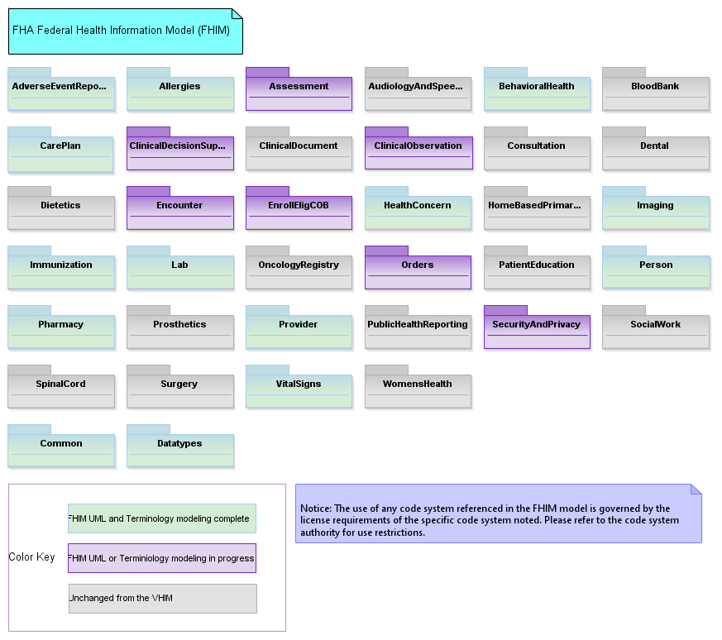
The FHIM Main Diagram

Slide 25
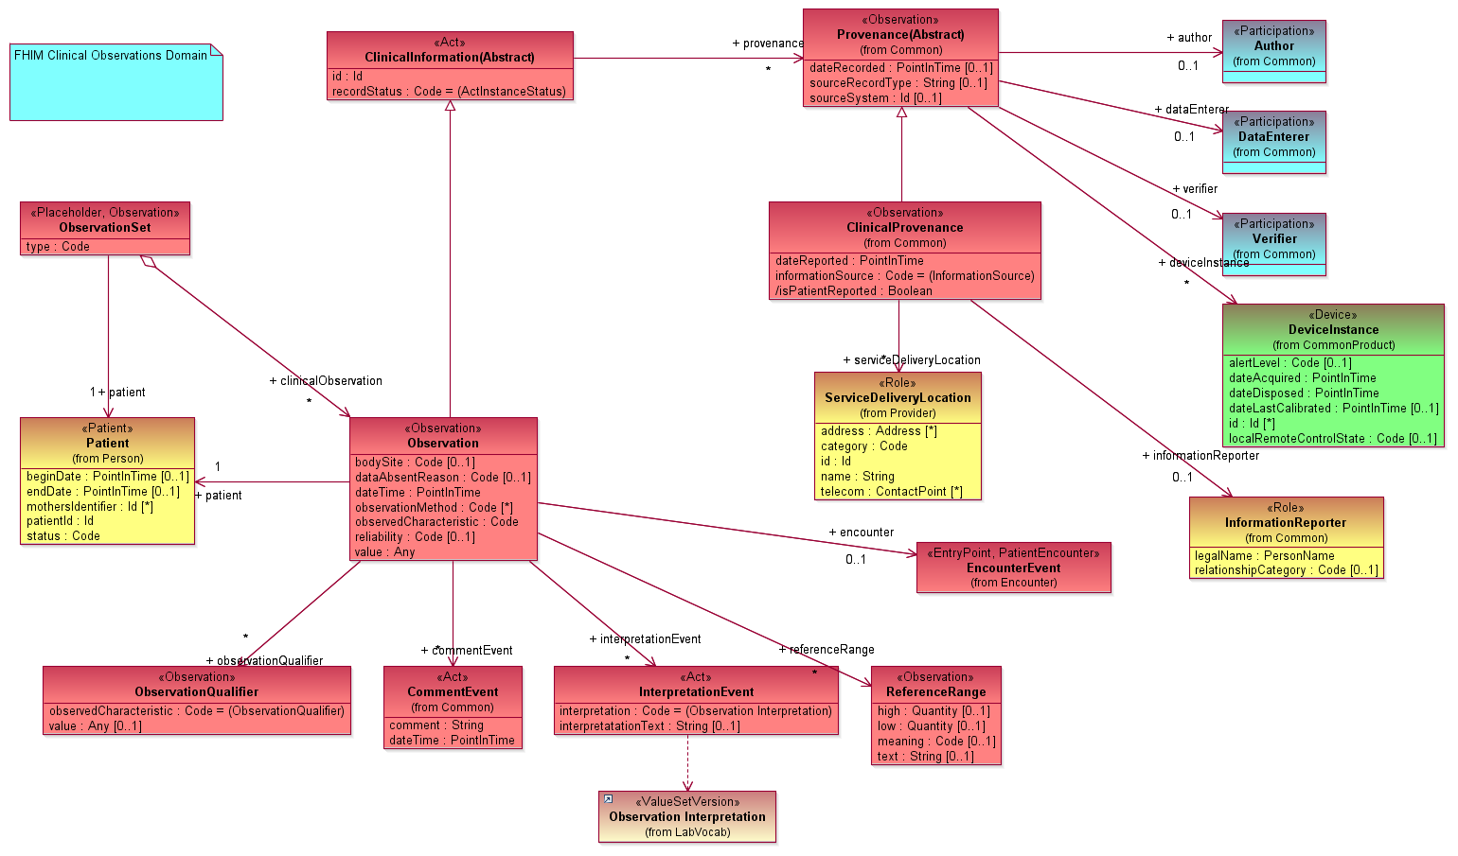
FHIM Clinical Observation

Slide 26
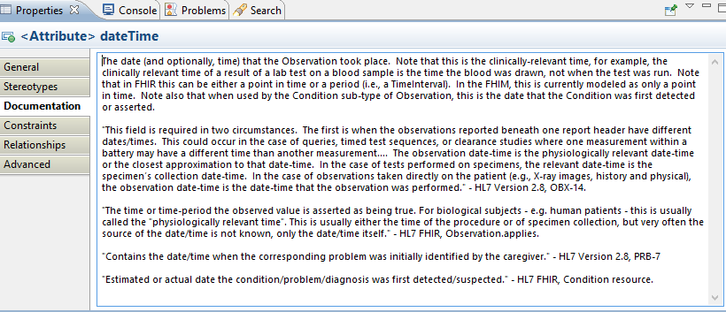
Documentation

Slide 27
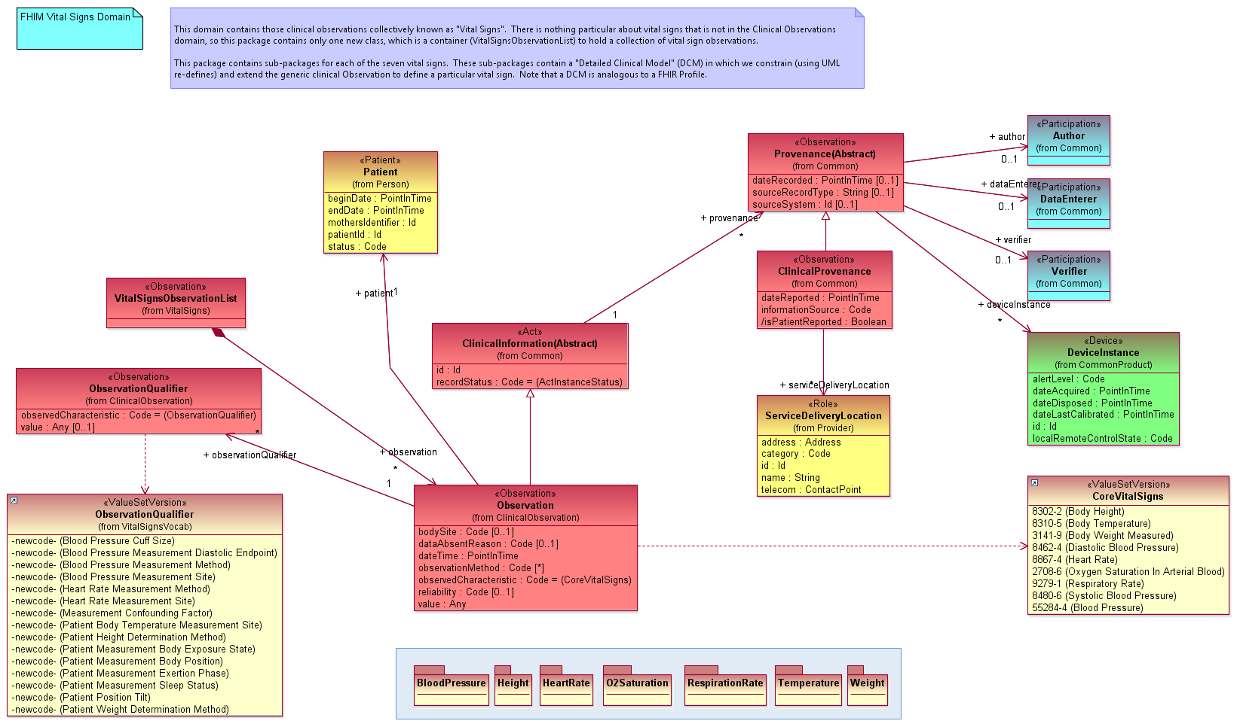
FHIM Vital Signs

Slide 28
FHIM “Detailed Clinical Models”
The FHIM primarily models generic structures like “Vital Signs”, which can accommodate any Vital Sign
Consistent with the approach of most standards
But we can create DCMs using UML “re-defines”
A re-define allows one to constrain a UML model by re-defining in a sub-type a property that was introduced in its super-type
The following slides show the Heart Rate DCM
Notes:
Please use the slide construction guidelines included on the next slide within your presentation.

Slide 29
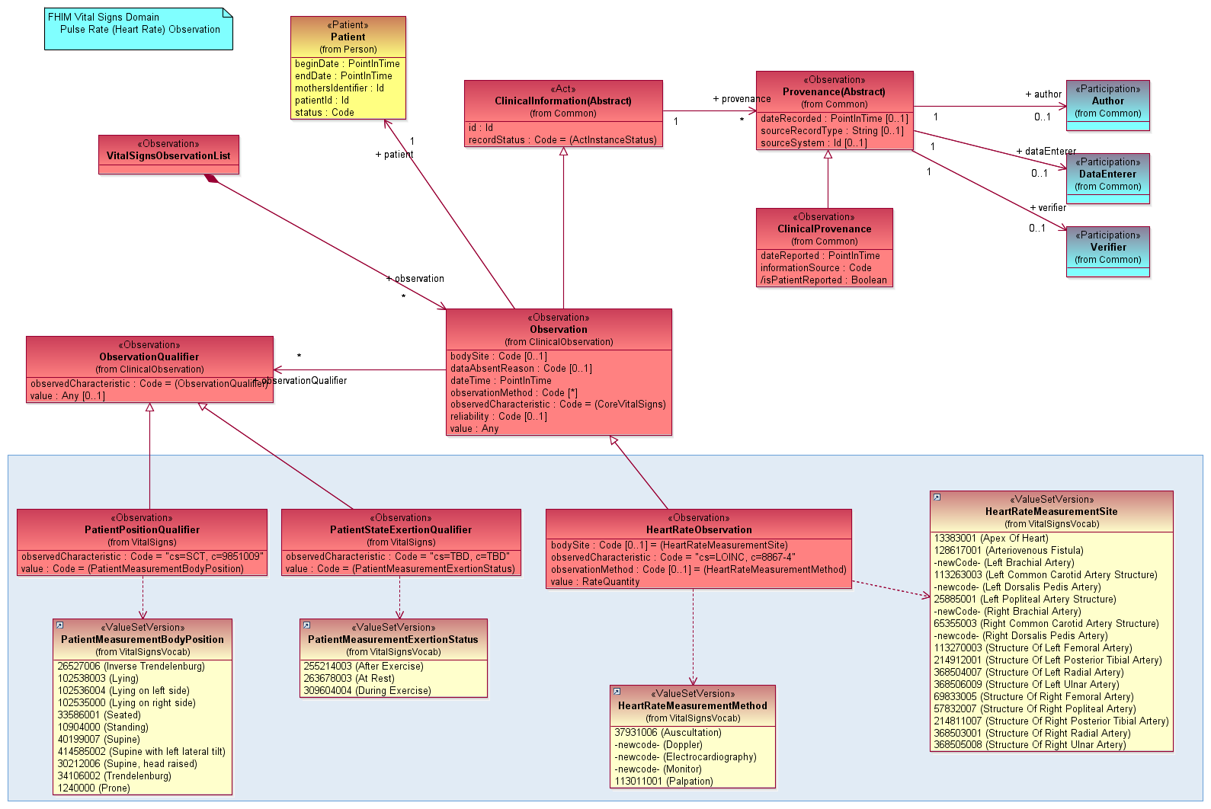
FHIM Vital Signs: Heart Rate

Slide 30
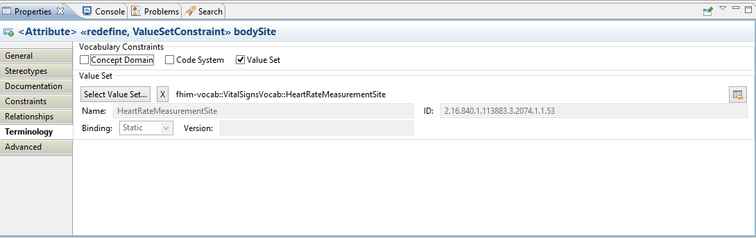
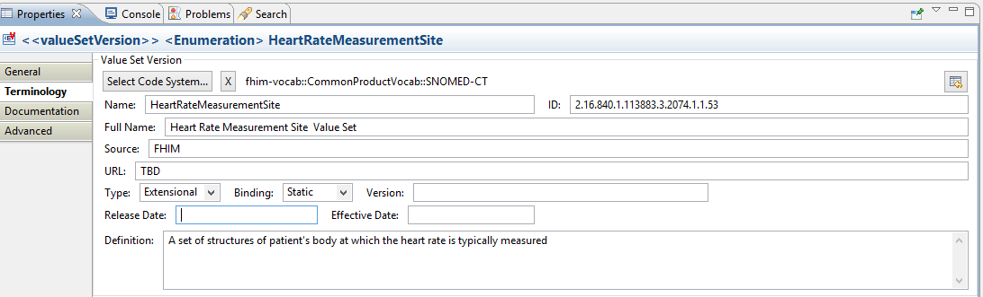
Terminology Binding in the FHIM
Once the value set is created VSAC, this will point to the page where it can be viewed

Slide 31
FHIM “Detailed Clinical Models” (cont)
We have demonstrated how DCMs can be modeled in the FHIM
But, while we “hand-built” the Vital Signs DCMs, we do not envision doing so for every DCM. We contend that the majority of DCMs should be generated from a knowledge base
Each DCM represents a set of possible values in the “code” and the “qualifiers” that could be related to post-coordinated concepts in a medical ontology (e.g., SOLOR)
Once generated into UML, the FHIM could then be used to generate implementable artifacts in multiple standard formats (e.g., FHIR, CDA, etc.)
Notes:
Please use the slide construction guidelines included on the next slide within your presentation.

Slide 32
Benefits of the FHIM
The FHIM provides the “missing logical model”
Can generate service payloads, both at the coarse and granular levels
FHIR JSON instance, or an HL7 v2 message
Test code for conformance of payloads
Notes:
Please use the slide construction guidelines included on the next slide within your presentation.
The FHIM provides the “missing logical model,” the absence of which hinders some standards individually, and the corpus of standards to which organizations must comply
In combination with MDHT, the FHIM can generate service payloads, both at the coarse grained level (e.g., Vital Signs) and at the fine grained level (e.g., Heart Rate)
Those payloads can be expressed in standard-compliant formats, e.g., a FHIR JSON instance, or an HL7 v2 message
Other code can be generated, including code to test conformance of the payloads

Slide 33
Thanks for Listening!
Any questions for Galen

Slide 34
Harmonization of the Information Models
Nona Hall, ONC Liaison, IPO

Slide 35
We Need to Simplify
LOINC:
1L: Gentamicin is a component LOINC (GENTAMICIN)
2L: Gentamicin Is a component of a laboratory tests in LOINC(Gentamicin Peak)
RxNorm:
1R: Gentamicin is an ingredient in RxNorm (Gentamicin Sulfate)
2R: Gentamicin is a basis of strength in RxNorm (Gentamicin)
3R: Gentamicin is linked to Human Prescription Drug Labels
4R: Gentamicin is presented in prescribed/dispensable forms in RxNorm
5R: Gentamicin is a product in RxNorm
SNOMED:
1S: Gentamicin is a substance in SNOMEDO CT (a component in LOINC)
2S: Gentamicin is a component of a laboratory test SNOMED (Gentamicin Peak)
3S: Gentamicin is a product in SNOMED CT (a substance manufactured and sold)
4S: Gentamicin is an allergen in SNOMED CT
5S: Gentamicin is presented in prescribed/dispensable forms in SNOMED
6S: Gentamicin is specified in SNOMED administration and removal procedures
7S: Gentamicin is specified in poisoning/overdoes
8S: Gentamicin allergic reactions are defined clinical situations
9S: Acute drug –induced renal failure is a disorder in SNOMED

Slide 36
We Need to Simplify (cont)
Lab LOINC
2S; 2L
1L; 1S; 1R
RXNorm: 2R; 3R
3S; 5S; 4R; 5R
SNOMED: 4S; 5S; 6S; 7S; 8S; 9S

Slide 37
Opportunities Ahead
Today, implementation is too complicated, and not interoperable, even when using well known standards.
FHIM exists to address one form of information modeling for the federal partners
CIMI exists to address another form of information modeling for an even broader (international) community
There are even more that need to come together, and more importantly they need to become routinely and consistently used and more meaningful to implementers
The Opportunity: via the Jan 2016 HL7 CIMI Modeling Working Group Meeting, an Investigative Study has been initiated to entertain the integration of
FHIM
CIMI/HSPC
QUICK/CQF
SOLOR
Through applied tooling of the MDHT/MDMI
A Two-Day Technical Forum has been added to accent on the opportunity—to all stakeholders

Slide 38
Integration Opportunity
QUICK (CQF)
SOLOR
CIMI/HSPC
FHIM
Notes:
How can we use an integration of Shared Logical Model implementation of SNOMED + LOINC + RxNorm as a foundation for FHIM, CIMI, and FHIR so that we can simplify our implementations, yet attain significant interoperability?
Stay tuned...

Slide 39
Modeling Workshop – August 17 & 18
Topic: Information Modeling – Foundation to Semantic Interoperability
Cosponsored by:
DoD/VA Interagency Program Office
Federal Health Architecture
ONC Office of Standards & Technology
Approach: Leverage DoD/VA IPO’s Health Interoperability Exchange Alliance (HIEA) Technical Forum
Content: Created and orchestrated by the SMEs
Notes:
At Deloitte HQ in Rosslyn, VA

Slide 40
Thanks for Listening!
Any questions for Nona?

Slide 41
CONNECT
Deepthi Rodrigues, Project Manager-CONNECT, FHA

Slide 42


CONNECT
CONNECT is a software platform that supports secure health information exchange
CONNECT uses industry standards like ONC Nationwide Health Information Network to ensure interoperability with current and future exchanges
CONNECT is an open source solution that is designed to be flexible to support an evolving health data exchange environment

Slide 43

FHA Collaborative Mindset drives CONNECT
Management, Support & Development
Policy
Governance ONC, Federal Health Architecture
Coordination, Dev., Support, Communications Federal Health Architecture Product Team
Requirements & Contributions
Specifications & Standards
Federal Partners DoD, CMS, SSA, VA, IHS, HHS/ONC
CONNECT Community via Forums, tickets
SOAP Based eHealth Exchange
SMTP Based Direct Project
SDOs (IHE, OASIS, WS-I, IETF, W3C, HL7, ANSI)
Certifications &Testing
Health Data Exchange eHealth Exchange, Direct, NIST, SITE
Notes:
Med, e.g. MedVA, MIHIN, UPMC

Slide 44

CONNECT Users

Slide 45








CONNECT Benefits

Slide 46
CONNECT Capabilities
Supports Industry Specifications to implement workflows and use cases:
NwHIN Patient Discovery
NwHIN Query for Documents,
NwHIN Retrieve Documents
NwHIN Document Submission
NwHIN Administrative Distribution
NwHIN CAQH Core X12 Document Submission
Direct (Applicability Statement for Secure Health Transport)
Notes:
Including support for multiple versions of the specifications

Slide 47
CONNECT Capabilities
Supports multiple versions of specifications
Includes deferred messaging
Large payload support through streaming
Performance and throughout levels to support national use cases
ATNA compliant audit logging for services.
Transaction logging across multiple NwHIN messages
Configurable services at deployment for reduced footprint
Event logging infrastructure for metric data
Parallel Message initiation and processing (Fan out)

Slide 48
CONNECT Capabilities
Supports multiple application servers : JBoss ,WebLogic, WebSphere, WildFly
Tested on multiple operating systems : Linux, Windows, Solaris, SPARC Solaris
Implements security testing processes and security scans using leading industry tools to improve code quality
System Admin Module (GUI framework for dashboard, testing utilities, configuring and managing CONNECT)

Slide 49
CONNECT – Features/Timeline
3.2.1
Deferred Patient Discovery
Audit Logging Improvements
Updates to the Universal Client
Onboarding Testing Support
2011
4.0/4.2
Direct Specification Support
Message Throughput and Performance
Multiple Application Server Support
Event Logging and Usage Metrics
Build Refinements and Application Stability
2012
2013
4.5
Gateway Admin
X12 Auditing
Auto of Direct Tests
FHIR/HPD Demos
3.3
Multiple Spec Version Support
Configurable Services at Install
Message Fan Out
Support for Clustering
Performance Tuning
2015
2014
4.6
Specification compliant Audit logging/viewer
Security testing - Fortify, SonarQube, OWASP
eHealth Exchange Validated Product
4.3/4.4
NwHIN CAQH Core X12
Testing Rigor and Automation
Support for Certifications (eHEX/ Product, NIST/ MU2)
Industry Security Scans
System Admin Module GUI
2016
49

Slide 50
More Information….
Website : www.connectopensource.org
Wiki: https://connectopensource.atlassian.net/wiki/
Ticket tracking: https://connectopensource.atlassian.net/secure/RapidBoard.jspa
Forums : http://www.connectopensource.org/developer-resources/forums
Latest release CONNECT 4.6 (March 2016): https://connectopensource.atlassian.net/wiki/display/CONNECT4/CONNECT+4.6

Slide 51
Thanks for Listening!
Any questions for Deepthi?

Slide 52



FHA Communications
e-mail: federal.health@hhs.gov
website: www.healthit.gov/FHA
Social Networks:
@onc_fha
Find us on LinkedIn!
The Pulse: Bimonthly Publication
Weekly Bulletin: for federal partners
Notes:
For signing up – email us at federal.health@hhs.gov
Weekly Bulletin: for federal partners

Slide 53

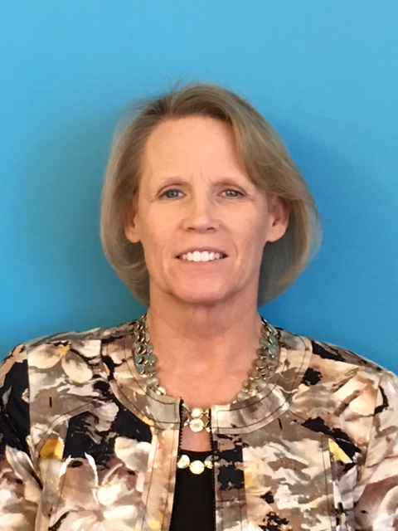


For more information…
About FHA:
Email: federal.health@hhs.gov
Website:
www.healthit.gov/FHA
Harmonization of Information Models
Email:
Nona.Hall@hhs.gov
Website:
www.healthit.gov
CONNECT
Email:
deepthi.rodrigues@
cgifederal.com
Website:
www.connectopensource.org
FHIM
Email:
Galen.Mulrooney@jpsys.com
Website:
www.FHIMS.org

